Slide 1

6th Grade Accelerated Math
Unit 15, Lesson 6 Simulating Small and Large Numbers of Trials Volume 2, pg. 426

Slide 2


Benchmark
MA.7.DP.2.4
Use a simulation of a simple experiment to find experimental probabilities and compare them to theoretical probabilities.
volume 2, pg. 426

Slide 3

Learning Target
I can compare the experimental probability from a simulation to the theoretical probability of a simple experiment.
I can use results from computer-simulated events to informally define the Law of Large Numbers.
volume 2, pg. 426

Slide 4

Warm-Up
volume 2, pg. 427

Slide 5
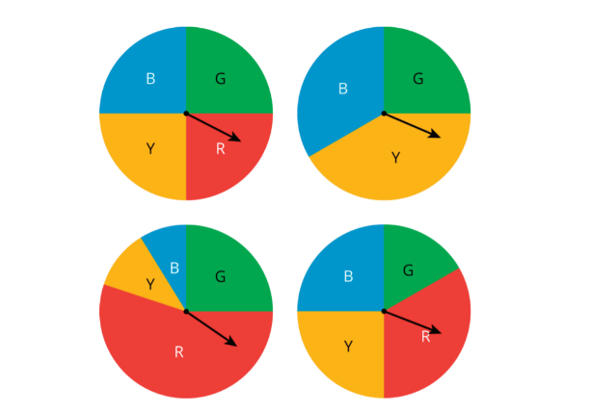
15.6.1 Warm-Up: Which One Doesn’t Belong?
Four spinners are shown.
a. Which spinner doesn’t belong?
b. Explain your reasoning.
volume 2, pg. 427

Slide 6

Exploration
volume 2, pg. 427

Slide 7

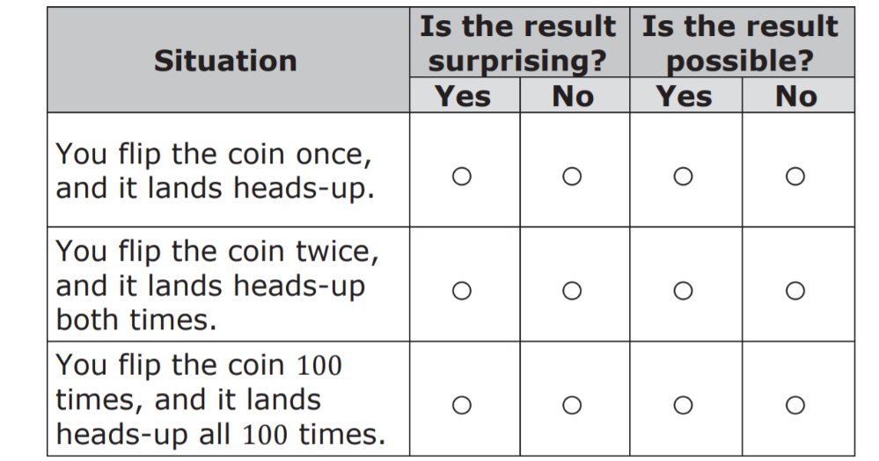
15.6.2 Exploration: Comparing Experimental Results to Expected Results
Work with your partner to complete the following.
When performing the simple experiment of flipping a coin over repeated trials, imagine each of the resulting situations listed in the table.
a. Complete the table to describe the results.
volume 2, pg. 427

Slide 8
If you flip the coin 100 times, explain how many times you would expect the coin to land heads-up.
With your partner, discuss some other results that would not be surprising if you flip the coin 100 times.
volume 2, pg. 427

Slide 9
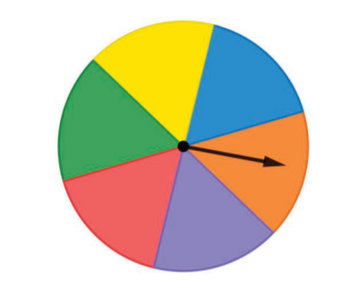
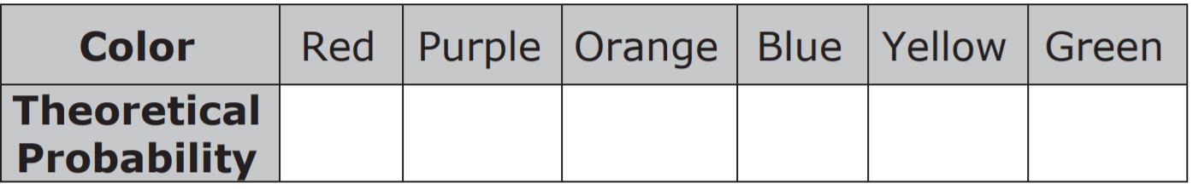
2. A spinner is shown.
Find the theoretical probability of landing on each color as a percentage rounded to the nearest tenth.
volume 2, pg. 428

Slide 10
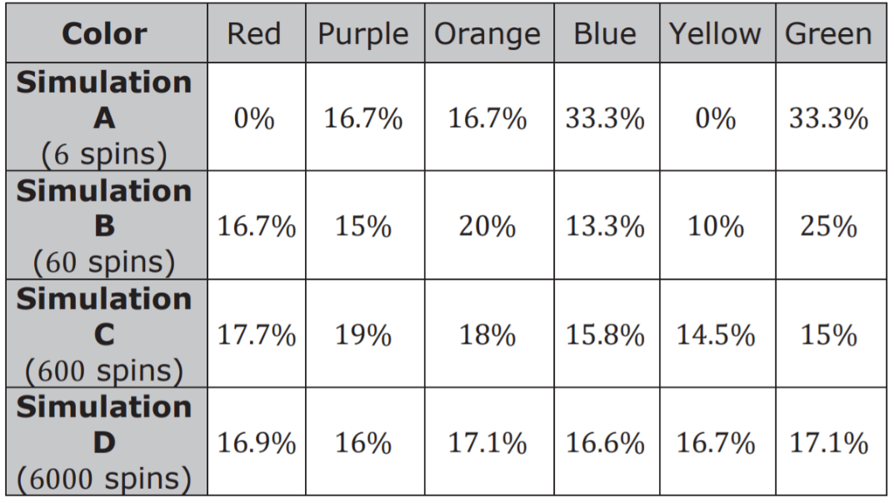
Sara used a computer-simulated spinner to perform different numbers of trials with the spinner. The results show the percentage of times it landed on each color in each simulation.
Circle the experimental probabilities that are more
than 1% different from the theoretical probability.
volume 2, pg. 428

Slide 11
Discuss with your partner what you notice when comparing the experimental probabilities to the theoretical probabilities.
In which simulation(s) were the experimental probabilities the most different from the theoretical probabilities?
In which simulation(s) were the experimental probabilities the most similar to the theoretical probabilities?
Imagine Sara used the computer-simulated spinner to perform 600,000 spins. Describe how you think the experimental probabilities of landing on each color would compare to the theoretical probabilities.
volume 2, pg. 428

Slide 12

Bring It Together
volume 2, pg. 429

Slide 13


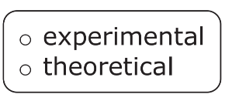
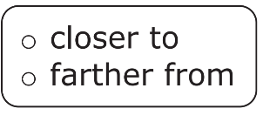
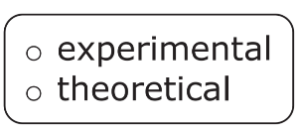
15.6.3 Bring It Together: Comparing Experimental Results to Expected Results
A simulation is an approximate imitation of a statistical experiment, often done with a
computer program to examine the statistics of a large quantity of trials.
Complete the statement.
As the number of trials in a simulation of a simple
experiment increases, the probability
gets the probability
volume 2, pg. 429

Slide 14

Imagine flipping a coin 3 times, and it has come up heads once. The experimental probability of landing on heads after 3 trials is 1/3. Discuss with your partner whether flipping the coin one more time is guaranteed to result in landing on heads so the experimental probability, 2/4, will equal the theoretical probability 1/2.
Simulations are useful when it is hard or time consuming to gather enough information to estimate the probability of some event.
When performing simple experiments, the experimental probabilities may differ from theoretical probabilities due to random variation. However, as the number of repetitions increases, experimental probabilities will typically better approximate the theoretical probabilities.
volume 2, pg. 429

Slide 15
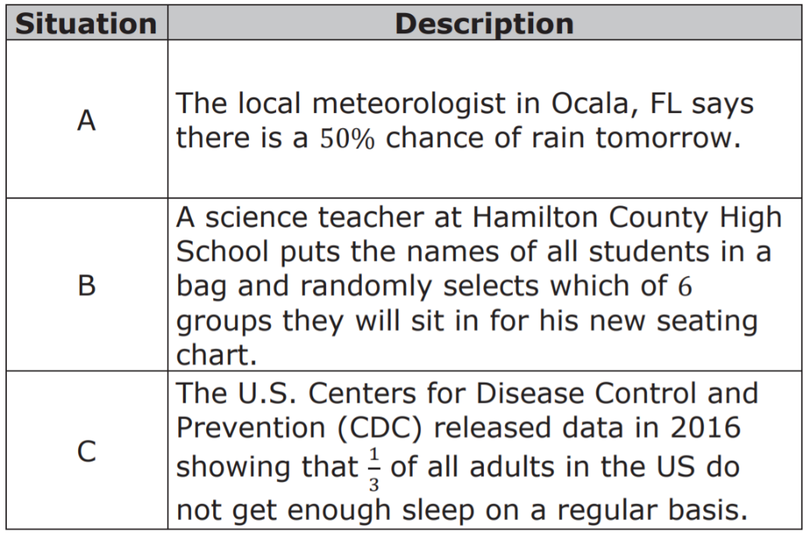
Consider the situations described in the table.
Explain which situation could be simulated using the spinner from the Exploration.
volume 2, pg. 429

Slide 16

Try It
volume 2, pg. 430

Slide 17

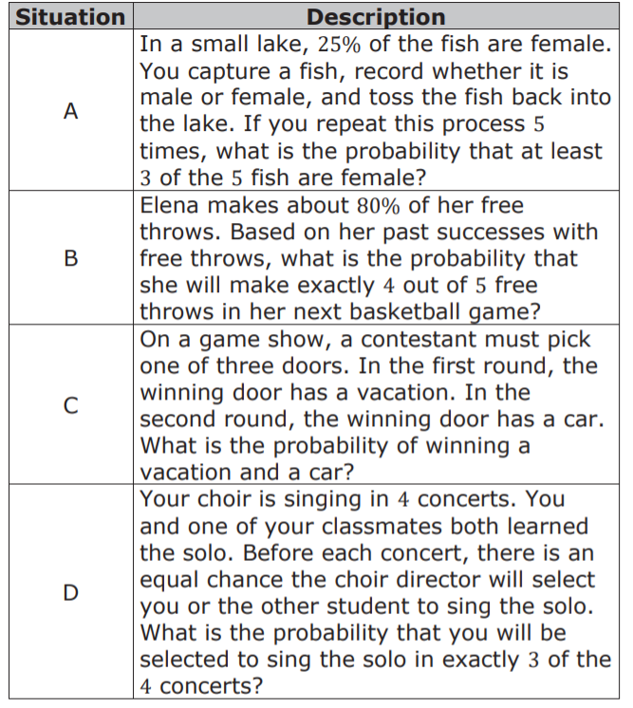
15.6.4 Try It: Using Simulations to Determine Experimental Probabilities
1. Four situations are described.
Work with your partner to match each situation to a simulation on the next page.
volume 2, pg. 430

Slide 18
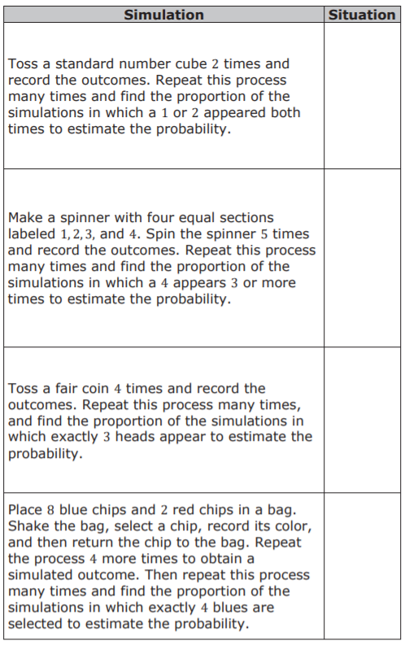
volume 2, pg. 430

Slide 19

Wrap-Up
volume 2, pg. 431

Slide 20

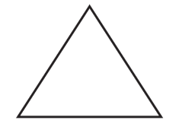

15.6.5 Wrap-Up: Reflections
What is something that is now “squared away” in your mind about simulating the probability of events?
What are three “points” that are important about simulating the probability of events?
What is something that is still “circling” your brain about simulating the probability of events?
volume 2, pg. 431

